Slide 1


Dynamic Traffic and Emission Management
Meghana S
Meghana M
Mentor: Sanjay S C
ACS College Of Engineering
Notes:
Let's delve deeper into the exciting world of sustainability and AI.
In this chapter, we'll explore how artificial intelligence can be a powerful tool for addressing environmental challenges and promoting sustainable practices. We'll discuss specific applications of AI in various sectors and analyze its potential to drive positive change.
Get ready to discover the innovative ways AI is contributing to a more sustainable future!

Slide 2

Project Objectives
Problem Statement
Project Overview – Introduction
End Users
Wow Factor in Project
Modelling/Block Diagram/Flow of Project
Result/outcomes
Conclusion
Future Perspective
Notes:
Let's outline what you'll learn in this presentation.
By the end, you'll be able to:
Understand how AI helps solve problems like climate change, resource depletion, and biodiversity loss.
Identify key AI uses in energy efficiency, waste management, and climate change.
Analyze AI's role in sustainable agriculture and cities.
Evaluate AI's use in environmental monitoring using satellites, real-time data, and predictions.
Apply AI strategies in logistics and transportation to make them more sustainable.
Get ready to discover how AI can help create a greener future!

Slide 3
Problem Statement
Indian metropolitan cities like Bengaluru face severe traffic congestion and rising air pollution due to non-adaptive traffic control systems. Static signals and manual traffic management lead to inefficient vehicle movement and high emission levels.
The lack of intelligent systems that can analyze real-time traffic and pollution data creates a pressing need for AI-based dynamic traffic and emission management solutions tailored for smart city infrastructure.
Notes:
Sustainability and AI
Sustainability is important because it helps meet our needs now and in the future. It includes protecting the environment, reducing pollution, and improving economic and social well-being.
AI can help us achieve sustainability. AI can process data, make predictions, and optimize systems to solve problems like resource management, environmental conservation, and energy efficiency.
Examples:
Smart grids: Reduce energy consumption.
Agriculture: Optimize water and fertilizer use.
Biodiversity: Monitor wildlife to protect biodiversity.
AI is a powerful tool for creating a more sustainable future.

Slide 4
Project Overview – Introduction
This project aims to develop an intelligent system that monitors and controls urban traffic flow in real time while minimizing vehicle emissions. Using AI, computer vision, and IoT sensors, the system detects traffic density and air quality to dynamically adjust signal timings.
Rapid urban growth has led to severe traffic congestion and increased air pollution in cities. Traditional traffic signals operate on fixed timings, failing to adapt to real-time traffic variations. This project introduces an AI-based dynamic traffic management system that analyzes live traffic and emission data to optimize signal operations. By integrating machine learning and sensor technologies, the system ensures smoother traffic flow, reduced fuel wastage, and lower emission levels, supporting smart city development.
Notes:
Sustainability and AI
Sustainability is important because it helps meet our needs now and in the future. It includes protecting the environment, reducing pollution, and improving economic and social well-being.
AI can help us achieve sustainability. AI can process data, make predictions, and optimize systems to solve problems like resource management, environmental conservation, and energy efficiency.
Examples:
Smart grids: Reduce energy consumption.
Agriculture: Optimize water and fertilizer use.
Biodiversity: Monitor wildlife to protect biodiversity.
AI is a powerful tool for creating a more sustainable future.

Slide 5
End Users
Traffic Management Authorities→ Use the system to monitor congestion and control signals dynamically.
Municipal & Smart City Departments→ Integrate the solution for efficient city-wide traffic and emission management.
Environmental Agencies→ Track real-time pollution data and identify emission hotspots.
Daily Commuters & Public Transport Operators→ Benefit from reduced travel time and improved air quality.
“Empowering cities and citizens through intelligent, eco-friendly traffic control.”
Notes:
Sustainability and AI
Sustainability is important because it helps meet our needs now and in the future. It includes protecting the environment, reducing pollution, and improving economic and social well-being.
AI can help us achieve sustainability. AI can process data, make predictions, and optimize systems to solve problems like resource management, environmental conservation, and energy efficiency.
Examples:
Smart grids: Reduce energy consumption.
Agriculture: Optimize water and fertilizer use.
Biodiversity: Monitor wildlife to protect biodiversity.
AI is a powerful tool for creating a more sustainable future.

Slide 6
Wow Factors in Project
⚙️AI That Thinks in Real-Time→ The system learns traffic behavior and autonomously adjusts signal timings like a human officer.
🌫 Dual Optimization – Traffic + Emissions→ Simultaneously reduces congestion and CO₂ output for eco-smart mobility.
🔮Predictive Intelligence→ Anticipates traffic build-ups before they occur using machine learning insights.
📊Smart City Integration→ Cloud dashboard enables city officials to monitor live traffic and emission data anytime, anywhere.
🤖Scalable & Self-Learning→ Capable of expanding across multiple junctions and improving performance over time.
Notes:
Sustainability and AI
Sustainability is important because it helps meet our needs now and in the future. It includes protecting the environment, reducing pollution, and improving economic and social well-being.
AI can help us achieve sustainability. AI can process data, make predictions, and optimize systems to solve problems like resource management, environmental conservation, and energy efficiency.
Examples:
Smart grids: Reduce energy consumption.
Agriculture: Optimize water and fertilizer use.
Biodiversity: Monitor wildlife to protect biodiversity.
AI is a powerful tool for creating a more sustainable future.

Slide 7
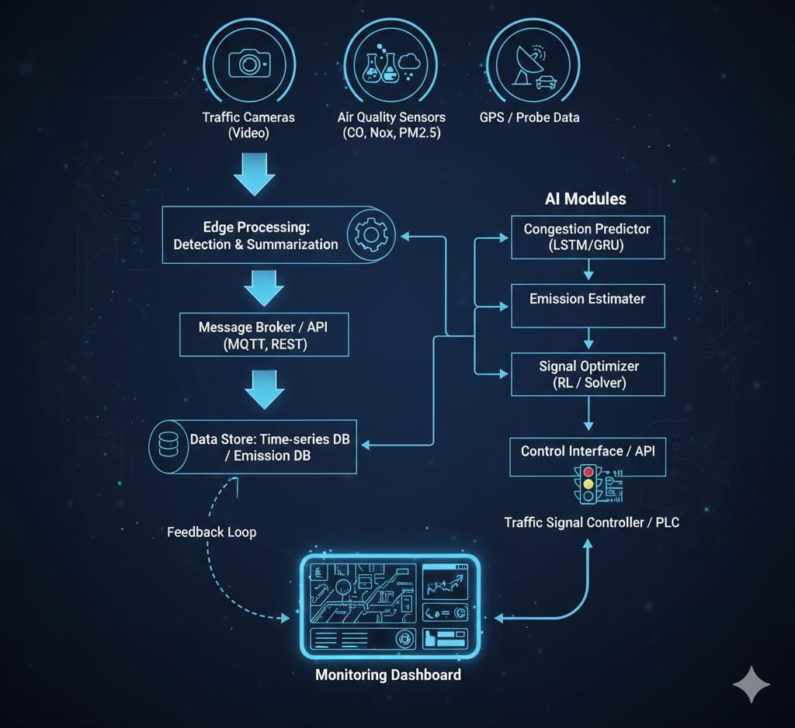
Modelling/Block Diagram/Flow of Project
Notes:
Sustainability and AI
Sustainability is important because it helps meet our needs now and in the future. It includes protecting the environment, reducing pollution, and improving economic and social well-being.
AI can help us achieve sustainability. AI can process data, make predictions, and optimize systems to solve problems like resource management, environmental conservation, and energy efficiency.
Examples:
Smart grids: Reduce energy consumption.
Agriculture: Optimize water and fertilizer use.
Biodiversity: Monitor wildlife to protect biodiversity.
AI is a powerful tool for creating a more sustainable future.

Slide 8
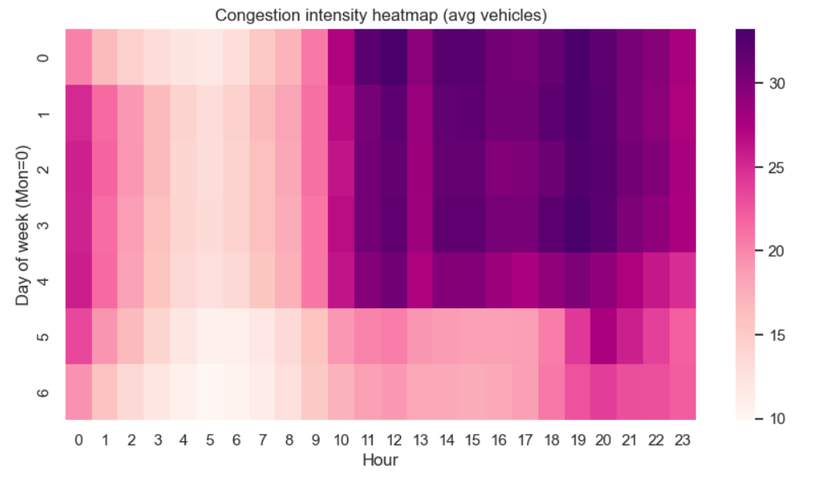
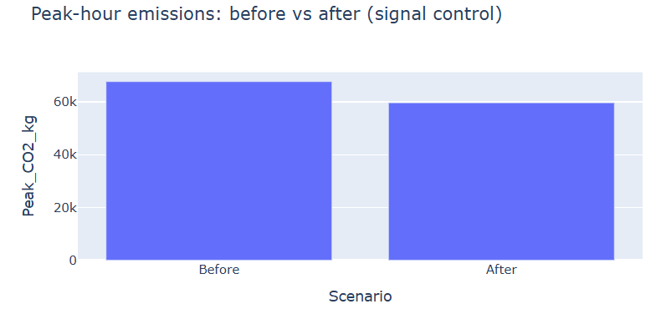
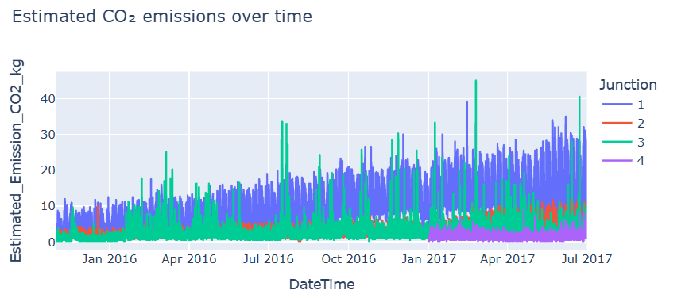
Result/Outcomes
Notes:
Sustainability and AI
Sustainability is important because it helps meet our needs now and in the future. It includes protecting the environment, reducing pollution, and improving economic and social well-being.
AI can help us achieve sustainability. AI can process data, make predictions, and optimize systems to solve problems like resource management, environmental conservation, and energy efficiency.
Examples:
Smart grids: Reduce energy consumption.
Agriculture: Optimize water and fertilizer use.
Biodiversity: Monitor wildlife to protect biodiversity.
AI is a powerful tool for creating a more sustainable future.

Slide 9
Conclusion
“Our project bridges intelligence and sustainability — transforming ordinary traffic systems into self-learning, eco-conscious networks.”
The proposed AI-driven framework enables adaptive, data-centric traffic regulation through real-time analytics. By correlating traffic density with emission metrics, the system achieves dual optimization of flow and environmental impact. Intelligent automation minimizes human intervention while ensuring efficient, sustainable urban mobility. he project establishes a scalable foundation for next-generation smart city traffic ecosystems.
Code link:
Notes:
Sustainability and AI
Sustainability is important because it helps meet our needs now and in the future. It includes protecting the environment, reducing pollution, and improving economic and social well-being.
AI can help us achieve sustainability. AI can process data, make predictions, and optimize systems to solve problems like resource management, environmental conservation, and energy efficiency.
Examples:
Smart grids: Reduce energy consumption.
Agriculture: Optimize water and fertilizer use.
Biodiversity: Monitor wildlife to protect biodiversity.
AI is a powerful tool for creating a more sustainable future.

Slide 10
Future Perspective
Integration with Vehicle-to-Infrastructure (V2I) Networks→ Enable direct communication between vehicles and traffic signals for predictive coordination and near-zero waiting time.
AI-Driven Emission Forecasting Model→ Extend the system to forecast city-wide emission trends using deep learning and meteorological data.
Autonomous Traffic Ecosystem→ Connect multiple intersections through a cooperative AI network that self-learns and synchronizes signals across the city grid.
Incorporation of Electric & Priority Vehicles→ Introduce intelligent lane/signal prioritization for emergency, electric, and public transport vehicles.
Edge–Cloud Hybrid Deployment→ Deploy lightweight AI agents at intersections (edge) for instant decisions, supported by cloud servers for large-scale analytics.
Policy & Citizen Integration→ Share real-time congestion and emission alerts with commuters through mobile apps to encourage eco-friendly route choices.
Notes:
Sustainability and AI
Sustainability is important because it helps meet our needs now and in the future. It includes protecting the environment, reducing pollution, and improving economic and social well-being.
AI can help us achieve sustainability. AI can process data, make predictions, and optimize systems to solve problems like resource management, environmental conservation, and energy efficiency.
Examples:
Smart grids: Reduce energy consumption.
Agriculture: Optimize water and fertilizer use.
Biodiversity: Monitor wildlife to protect biodiversity.
AI is a powerful tool for creating a more sustainable future.

Slide 11
Thank You
“Bridging intelligence and sustainability — transforming ordinary systems into self-learning, eco-conscious networks!!”
Notes:
Thank You !!

